Slide 1

ACADEMIC REPS

Slide 2
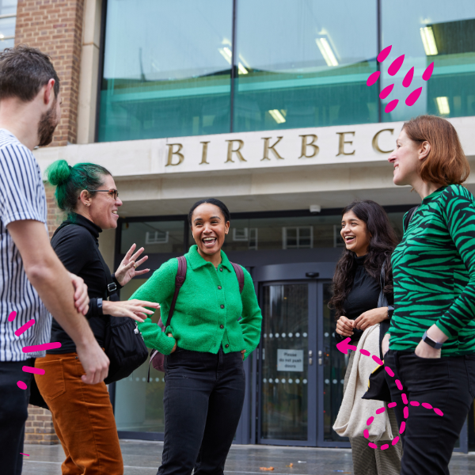

WELCOME FROM
BIRKBECK STUDENTS’ UNION
“Birkbeck SU is the place where students come together, it’s supportive, welcoming, and always working to make our experience better.”
— Birkbeck Student

Slide 3
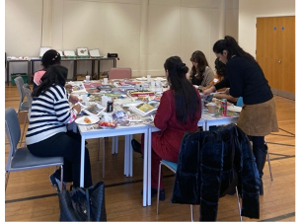
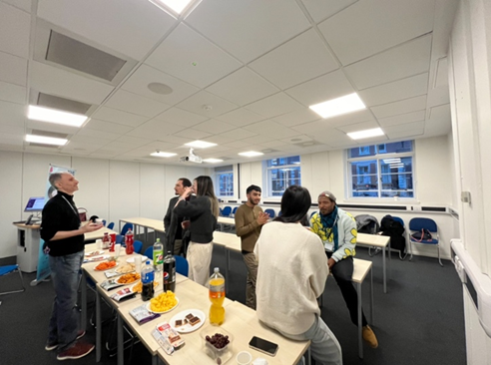
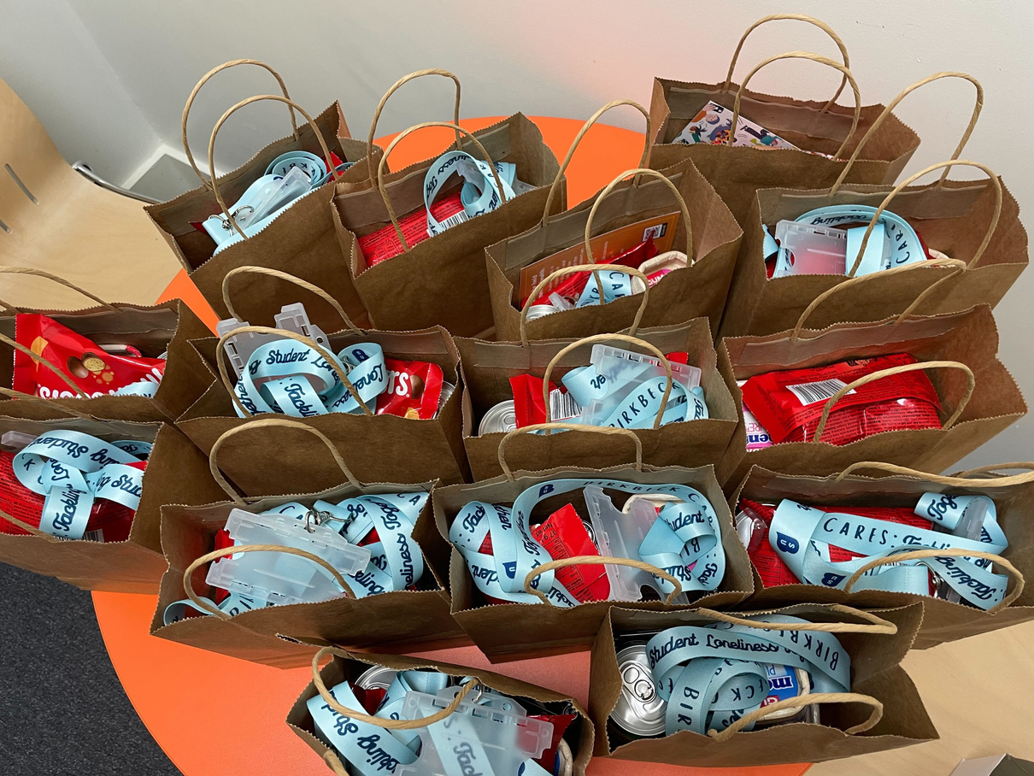
ACADEMIC REPS
Academic Reps are students just like you who put themselves forward to represent their classmates. They volunteer their time to share student feedback, making sure your voices are heard.

Slide 4

Academic Reps are a vital link between students and staff, helping to shape courses and improve the overall academic experience for everyone.

Slide 5

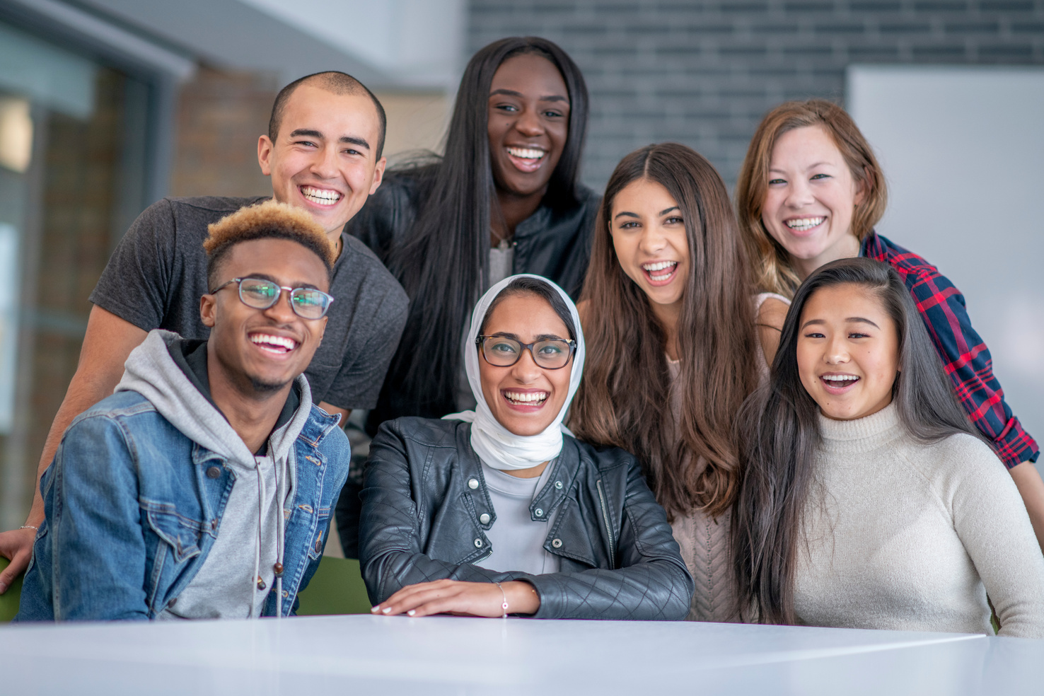

SUPPORT
The programme is run by your Students’ Union, and Reps take part in key feedback opportunities such as Student Voice meetings where they can make a real difference across the college.
Don’t worry, you won’t be doing it alone, the Students’ Union will train and support you every step of the way
Case Study 01

Slide 6


WHO CAN BE A REP?
There’s no limit to how many Academic Reps a cluster or programme can have. The more students who get involved, the stronger the voice and the more representative the feedback will be — and the best part is, you can all be a Rep!

Slide 7


WHY?
Many students choose to become Academic Reps not just to help improve the student experience, but also to boost their own future opportunities. Being a Rep looks great on your CV and job applications, as it shows initiative, proactiveness and responsibility (qualities employers really value!).

Slide 8
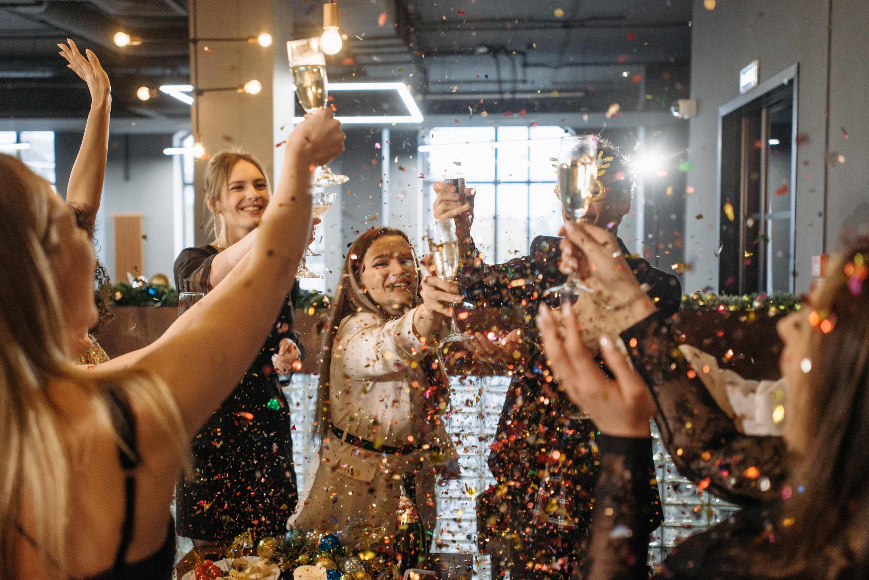
BENEFITS
  Play an active role in shaping and improving your course experience.
  Gain transferable skills in communication, teamwork, and leadership.
  Build confidence through working with staff and contributing to key decisions.
  Boost your employability with valuable experiences to showcase on your CV and in interviews.

Slide 9
“Being a Rep through Birkbeck SU has given me the chance to really make a difference, I feel like my voice matters, and I’ve helped improve things for my classmates.”
-PREVIOUS ACADEMIC REP

Slide 10

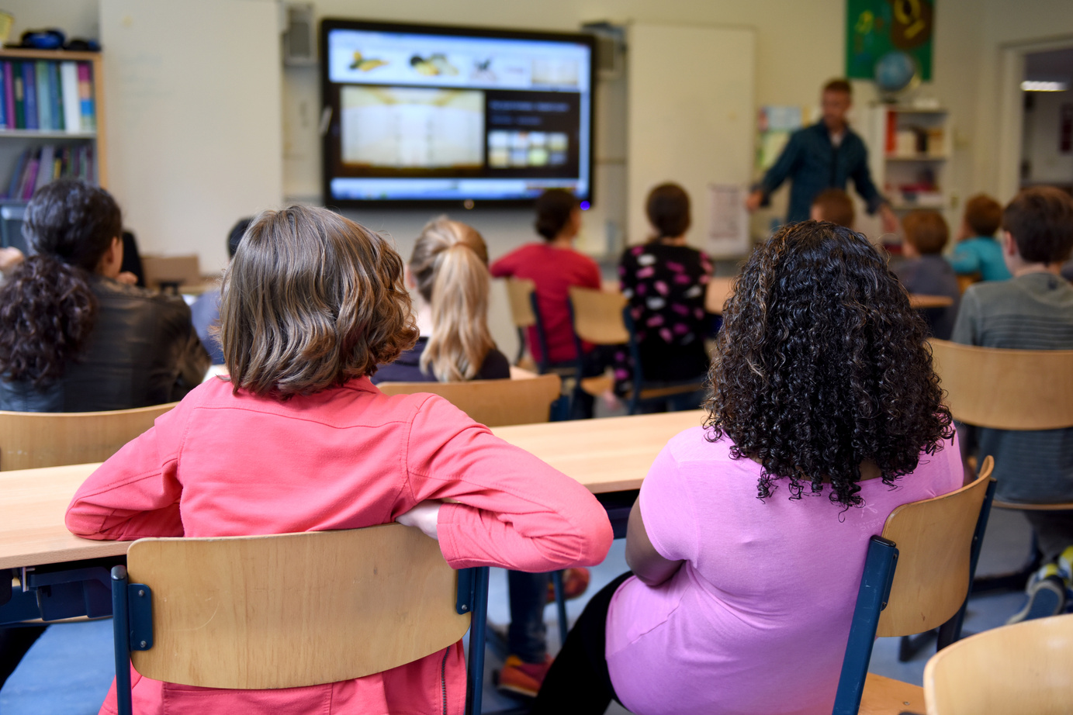


Listen to Students
WHAT DOES A REP DO?
Share with Staff
Work with the SU
Close the Loop

Slide 11




TIMELINE
Speak to your Programme Director and let them know you’d like to be a Rep.
Your Programme Lead will confirm your role by completing a form and sending it to the SU.
The Students’ Union will contact you directly for confirmation.
You’ll be signed up for Rep Training with the SU.
13th October 2025

Slide 12


PUT YOURSELF FORWARD
Ready to Make a Difference?
Become an Academic Rep and:
✔ Influence positive change on your course
✔ Develop skills that boost your CV
✔ Build confidence and leadership experience
✔ Connect with staff and fellow students
Speak to your programme lead today about becoming an Academic rep

Slide 13
THANK YOU

